Slide 1
Installation and Introduction to Docker Hub

Slide 2
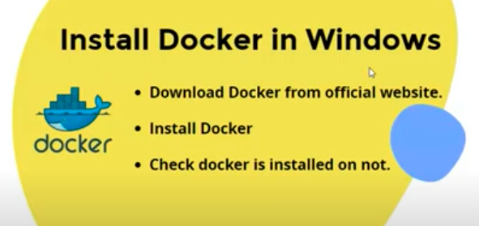
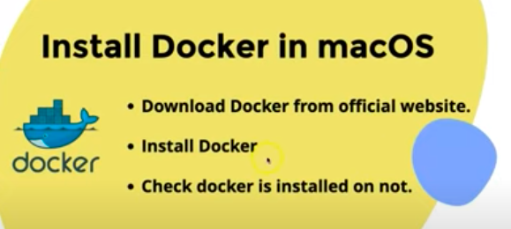
Link for installation :
https://www.docker.com/products/docker-desktop/

Slide 3
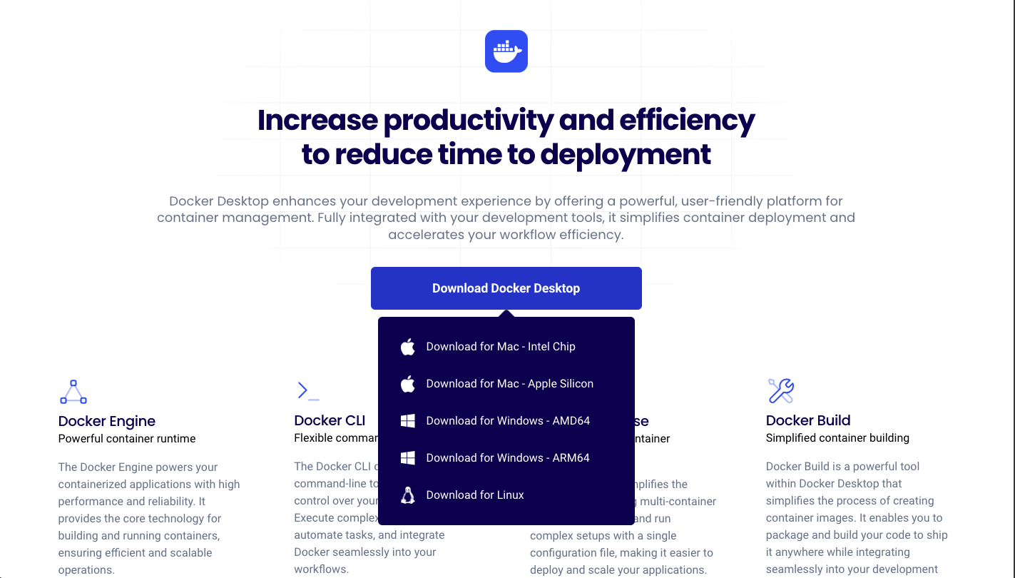

Slide 4
Commands to check the docker installation
To check the installation:
docker
To check version :
docker -v

Slide 5
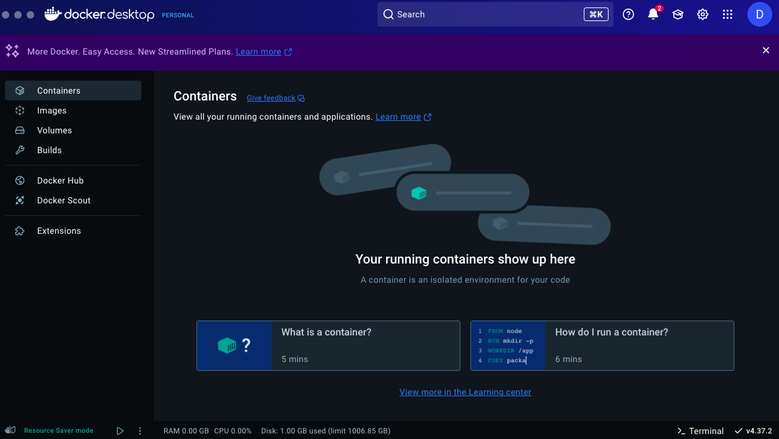

Slide 6
The Docker platform
Ability to package and run an application in a loosely isolated environment called a container.
The isolation and security lets you run many containers simultaneously on a given host.
Containers are lightweight and contain everything needed to run the application

Slide 7
Docker provides tooling and a platform to manage the lifecycle of your containers:
Develop your application and its supporting components using containers.
The container becomes the unit for distributing and testing your application.
When you're ready, deploy your application into your production environment, as a container or an orchestrated service.
This works the same whether your production environment is a local data center, a cloud provider, or a hybrid of the two.

Slide 8
Uses of Docker
Fast, consistent delivery of your applications.
Responsive deployment and scaling
Running more workloads on the same hardware

Slide 9
Docker Hub:
Docker Hub is a repository service and a cloud-based service.
Manage the sharing and storage of Docker images.
Contains the Push and Pull process for container images.
Can push your images as private or public.
Efficient Image Management

Slide 10
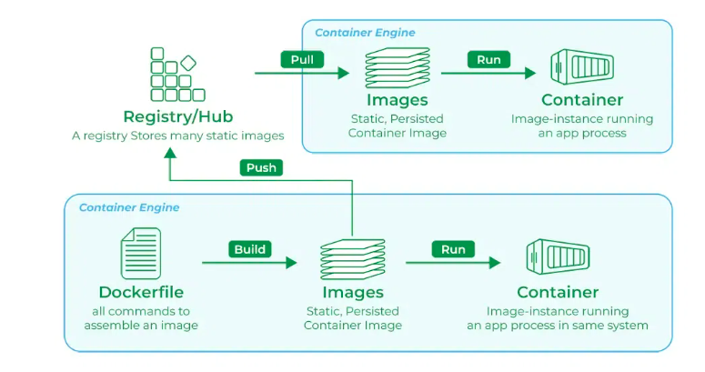
Docker hub Working

